Slide 1
Ensemble Learning
Y.LAKSHMI PRASAD
08978784848

Slide 2
Model everywhere…
Unsupervised – projection, grouping, density estimation
PCA, K-Means, KDE
Supervised – Classification
Logistic, Neural Networks, SVM
Decision Trees, K-Nearest Neighbor
Bayesian Classifiers –Naïve Bayes
Supervised – Regression
Linear Regression, Polynomial Regression, etc.
How to Handle Increasing Complexity of Decision Boundaries?

Slide 3
1. Choose Complex Models
Example: → Choose Polynomial vs. Linear
Needs: More training data and More training time,
Careful tuning of parameters – Bias/Variance Tradeoff
Training Set Accuracy
Right Level of Model Complexity
Model Accuracy
Validation Set Accuracy
Model Complexity

Slide 4
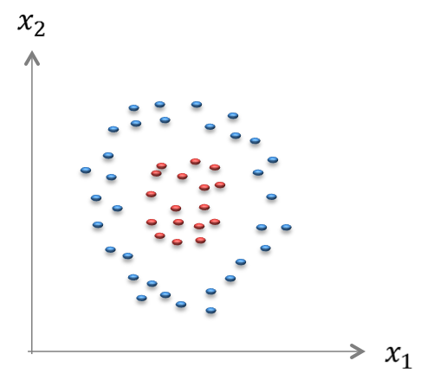
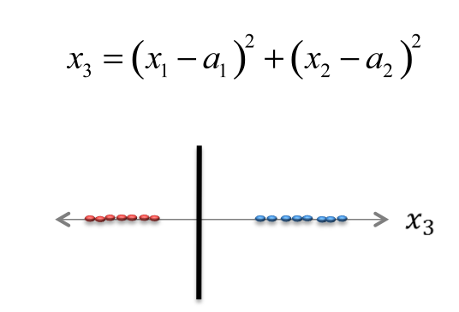
2. Engineer Better Features
Complex
Features
Simple
Model
Simple Features
Complex Model

Slide 5
3. Divide and Conquer
Instead of trying to learn a SINGLE COMPLEX model can we learn an ENSEMBLE of SIMPLE models and COMBINE their outputs?

Slide 6
Ensemble Learning
An ensemble means a group of things viewed as a whole rather than individually.
In ensembles, a collection of models is used to make predictions, rather than individual models.

Slide 7

Ensemble Methods
Vs
Phone a Friend in KBC
Audience Poll

Slide 8
Ensemble Methods
Asking a Single Person resembles like a Single Tree
Asking a Group of People resembles like multiple Decision Trees

Slide 9
Ensemble Methods
To combine the predictions of several base estimators built with a given learning algorithm in order to improve generalizability / robustness over a single estimator.
Two families of ensemble methods are usually distinguished:
1.Averaging methods: Bagging, Random Forest
2.Boosting methods: AdaBoost, Gradient boost, XGBoost

Slide 10
Averaging methods
The driving principle is to build several estimators independently and then to average / vote their predictions.
On average, the combined estimator is usually better than any of the single base estimator because its variance is reduced.
E.g. Bagging methods, Forests of randomized trees

Slide 11
Boosting methods
Base estimators are built sequentially and one tries to reduce the bias of the combined estimator.
The motivation is to combine several weak models to produce a powerful ensemble.
E.g. Ada-Boost, Gradient Boosting, XG-Boost.

Slide 12
Ensemble Learning
INPUT
Space PARTITION
Output Space COMBINER

Slide 13
Ensemble Learning
For an ensemble to work, each model of the ensemble should comply with the following conditions:
1. Each model should be diverse. Diversity ensures that the models serve complementary purposes, which means that the individual models make predictions independent of each other.
2. Each model should be acceptable. Acceptability implies that each model is at least better than a random model.

Slide 14
Ensemble Methods
1. Spend less time in pursuit of a single best model. Instead, train a number of reasonably strong learners
2. Bias of individual models is averaged out while lowering the variance errors
3. Improved performance compared to individual models in terms of performance Vs time to prepare.
4. Many models run into memory or computational limits when working with large data sets (both in volume and breadth).
5. Can handle complex data patterns easily than a fully loaded single model.

Slide 15
Ensemble Process
1. Selecting the Dataset
5. Aggregation
2. Generate Samples
3. Applying Learners
4. Generating Multiple Models
Image Source: Google

Slide 16
Ensemble Process
1. Taking “D” Dataset
2. Here, we will generate multiple samples (“M”) from the “D” Dataset. The sampling will be done by Replacement. This is called Bootstrap Sampling.
3. Once the “M” samples are generated. The learners are applied to train the classifier.
4. The learners on ”M” samples would generate multiple models with different Accuracy Levels
5. We will combine those models to improve the overall Accuracy. In classification, Voting is used & in Regression Models, we use Average.

Slide 17
How to find the right model?
Algorithm &
Complexity
Universe of all mappings
Training Parameters &
Initialization

Slide 18
Model Selection
1. Choosing the right modeling ALGORITHM.
2. Choosing the right COMPLEXITY of the modeling technique.
3. Choosing the right training HYPERPARAMETERS to train the model.

Slide 19
With Same Algorithm & Complexity
Which is the “BEST” model?
Is RANDOM model ok?
Can we build an AVERAGE model?
MODEL AVERAGING
Train SEVERAL Models
Take their AVERAGE
Algorithm &
Complexity

Slide 20
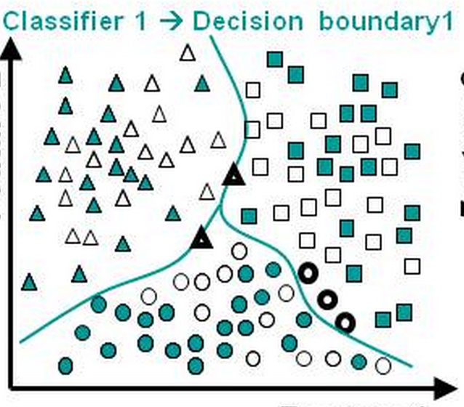
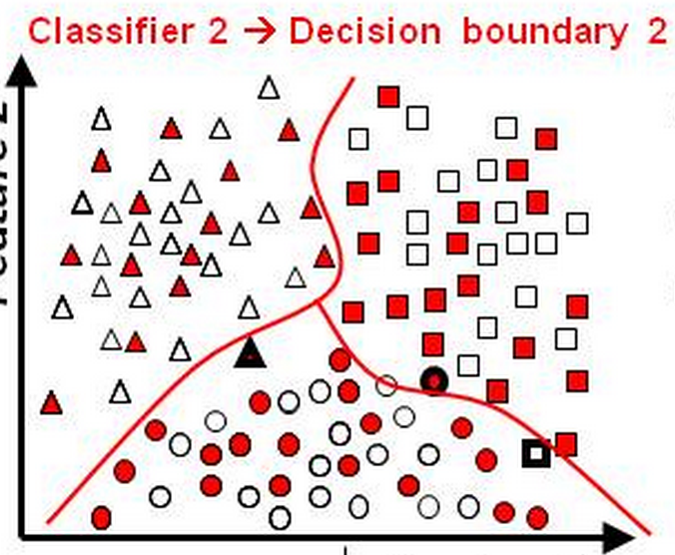
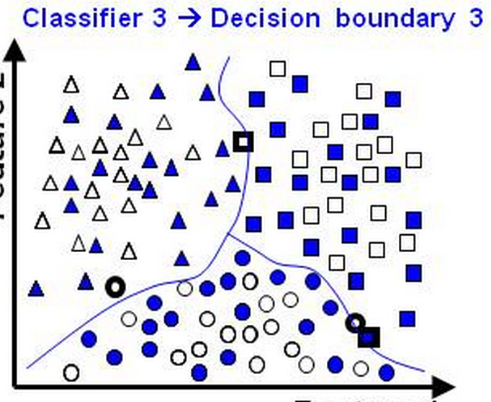
Ensemble by Training Sample

Slide 21
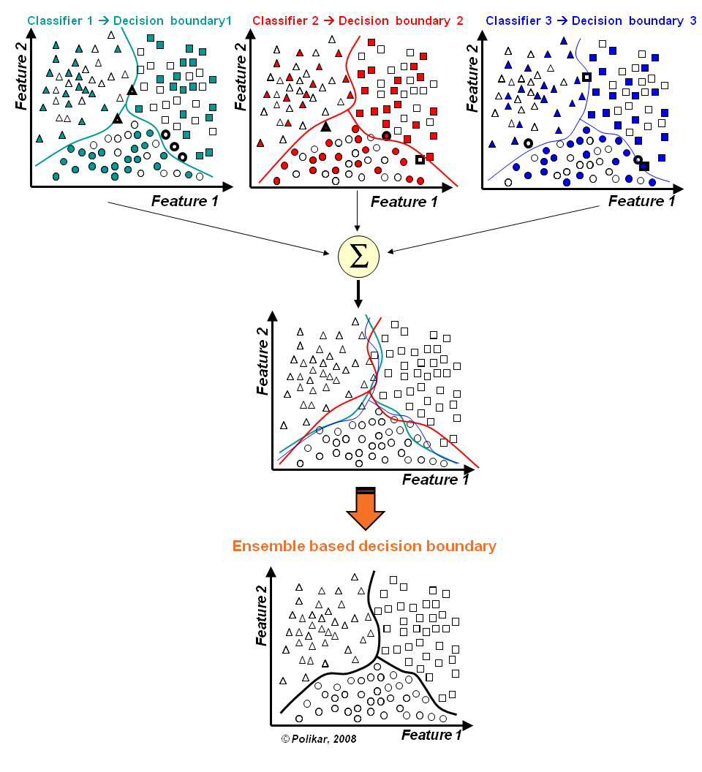
Ensemble by Training Sample
In the final stage of voting, we essentially have a combined surface resulting from individual surfaces

Slide 22
Industry Examples - Ensembles
Recommender Systems
Malware Detection
Fraud Detection
Face Detection Problems

Slide 23
Questions?

